Slide 1
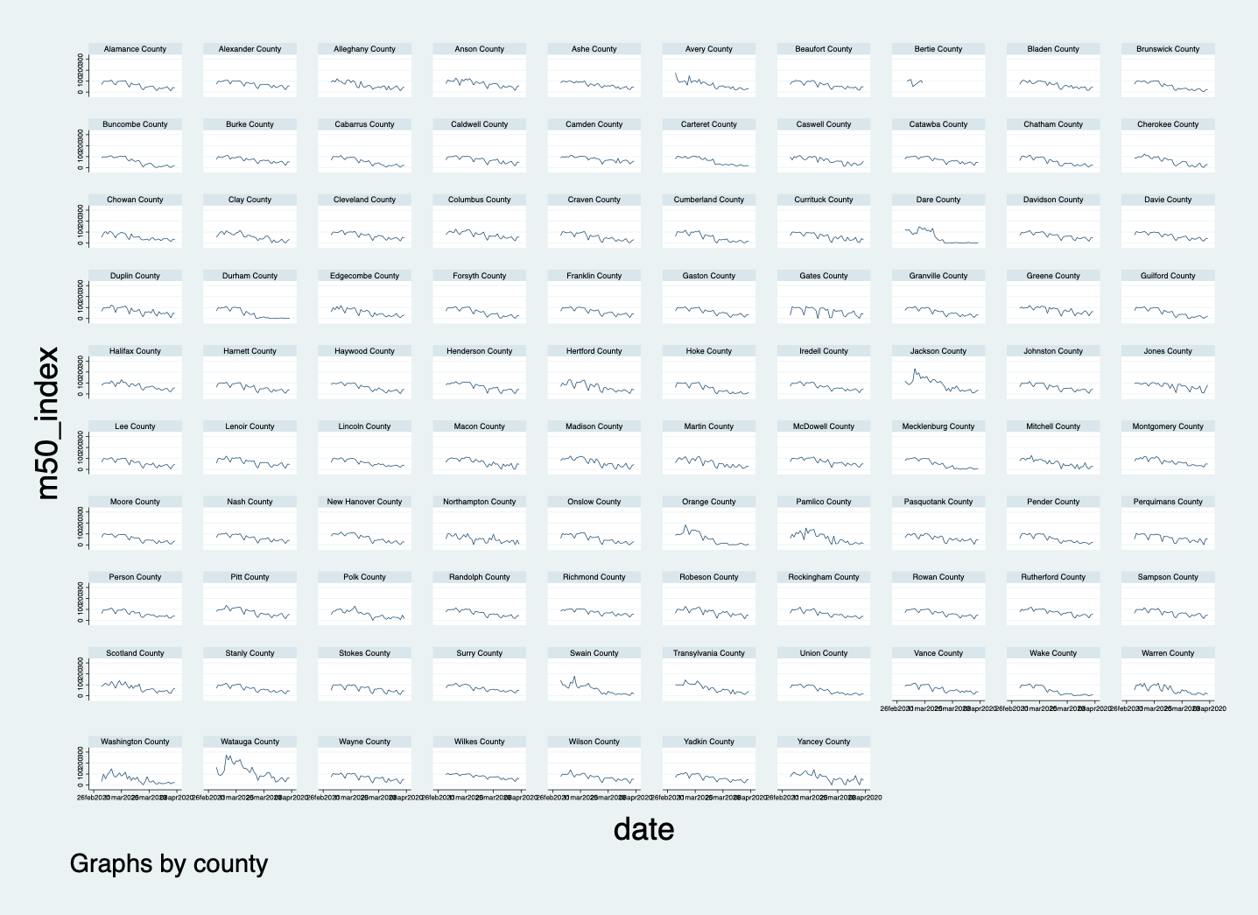

Slide 2
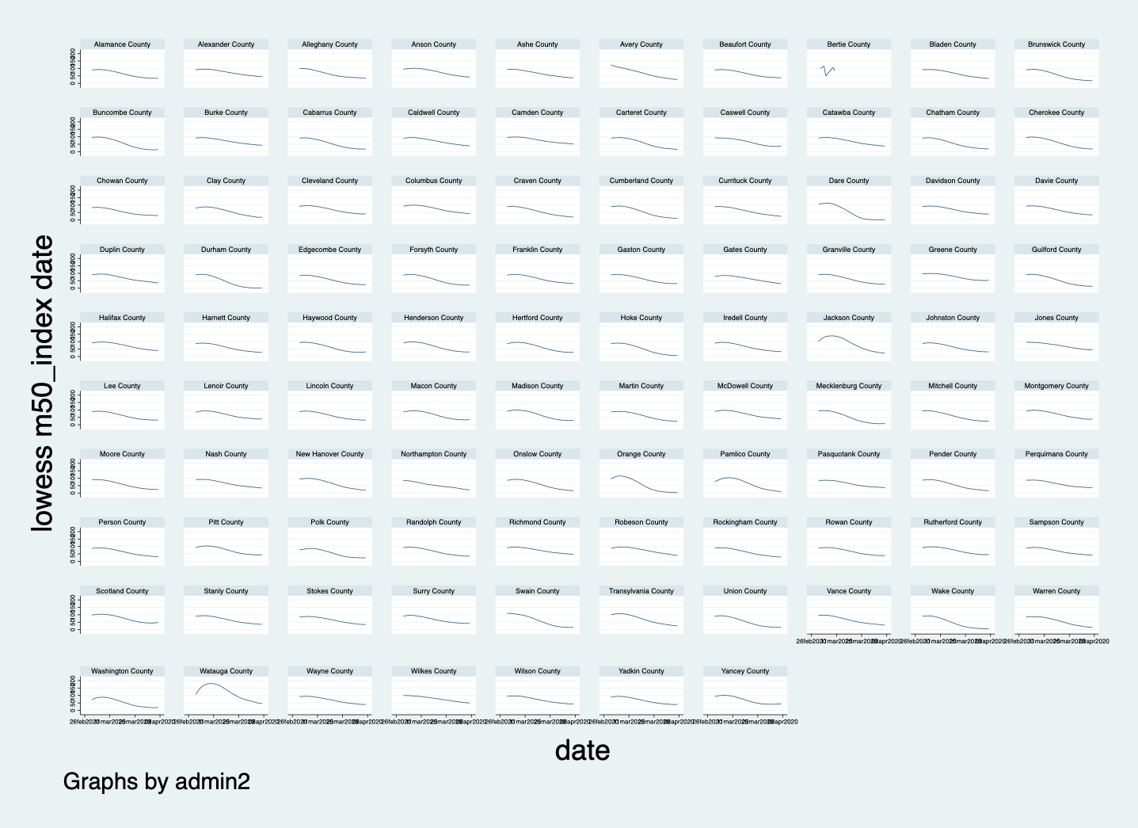

Slide 3
Early social distancing: evidence of privilege in a pandemic from smartphones
Authors: Nabarun Dasgupta*1, Michele Jonsson Funk1, Allison Lazard1, Benjamin Eugene White1, Steve W. Marshall1
Abstract: Aggregated location data from smartphones can quantify implementation of social distancing countermeasures during a pandemic. Examine whether healthier and wealthier places are more successful at implementing social distancing. Social distancing intensity was quantified using aggregate smartphone location data from 2,507 US counties, and linked to four healthcare and two economic indicators.
From 02-March to 20-March 2020, smartphone movement decreased by 35% (quintile range: 5%, 68%). Counties in the highest quintile of social distancing had: 52% higher primary care and 51% higher mental health providers, 70% fewer uninsured, 13% higher influenza vaccination, 31% higher annual income, and 10% less income disparity, relative to the lowest quintile. Healthier and wealthier areas appear to be more successful at implementing social distancing. This disparity may have implications for disease incidence.

Slide 4
